Slide 1
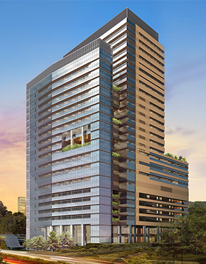

PROPOSED ERECTION OF 24 STOREY WITH 4 BASEMENTS
NEW NATIONAL CANCER CENTRE
ON LOT 00467K TS22 AT OUTRAM MEDICAL CAMPUS 20 OUTRAM ROAD (BUKIT MERAH PLANNING AREA)
16 JANUARY 2019
PROJECT BRIEFING
by:

Slide 2
Intro to Building demarcation

Slide 3
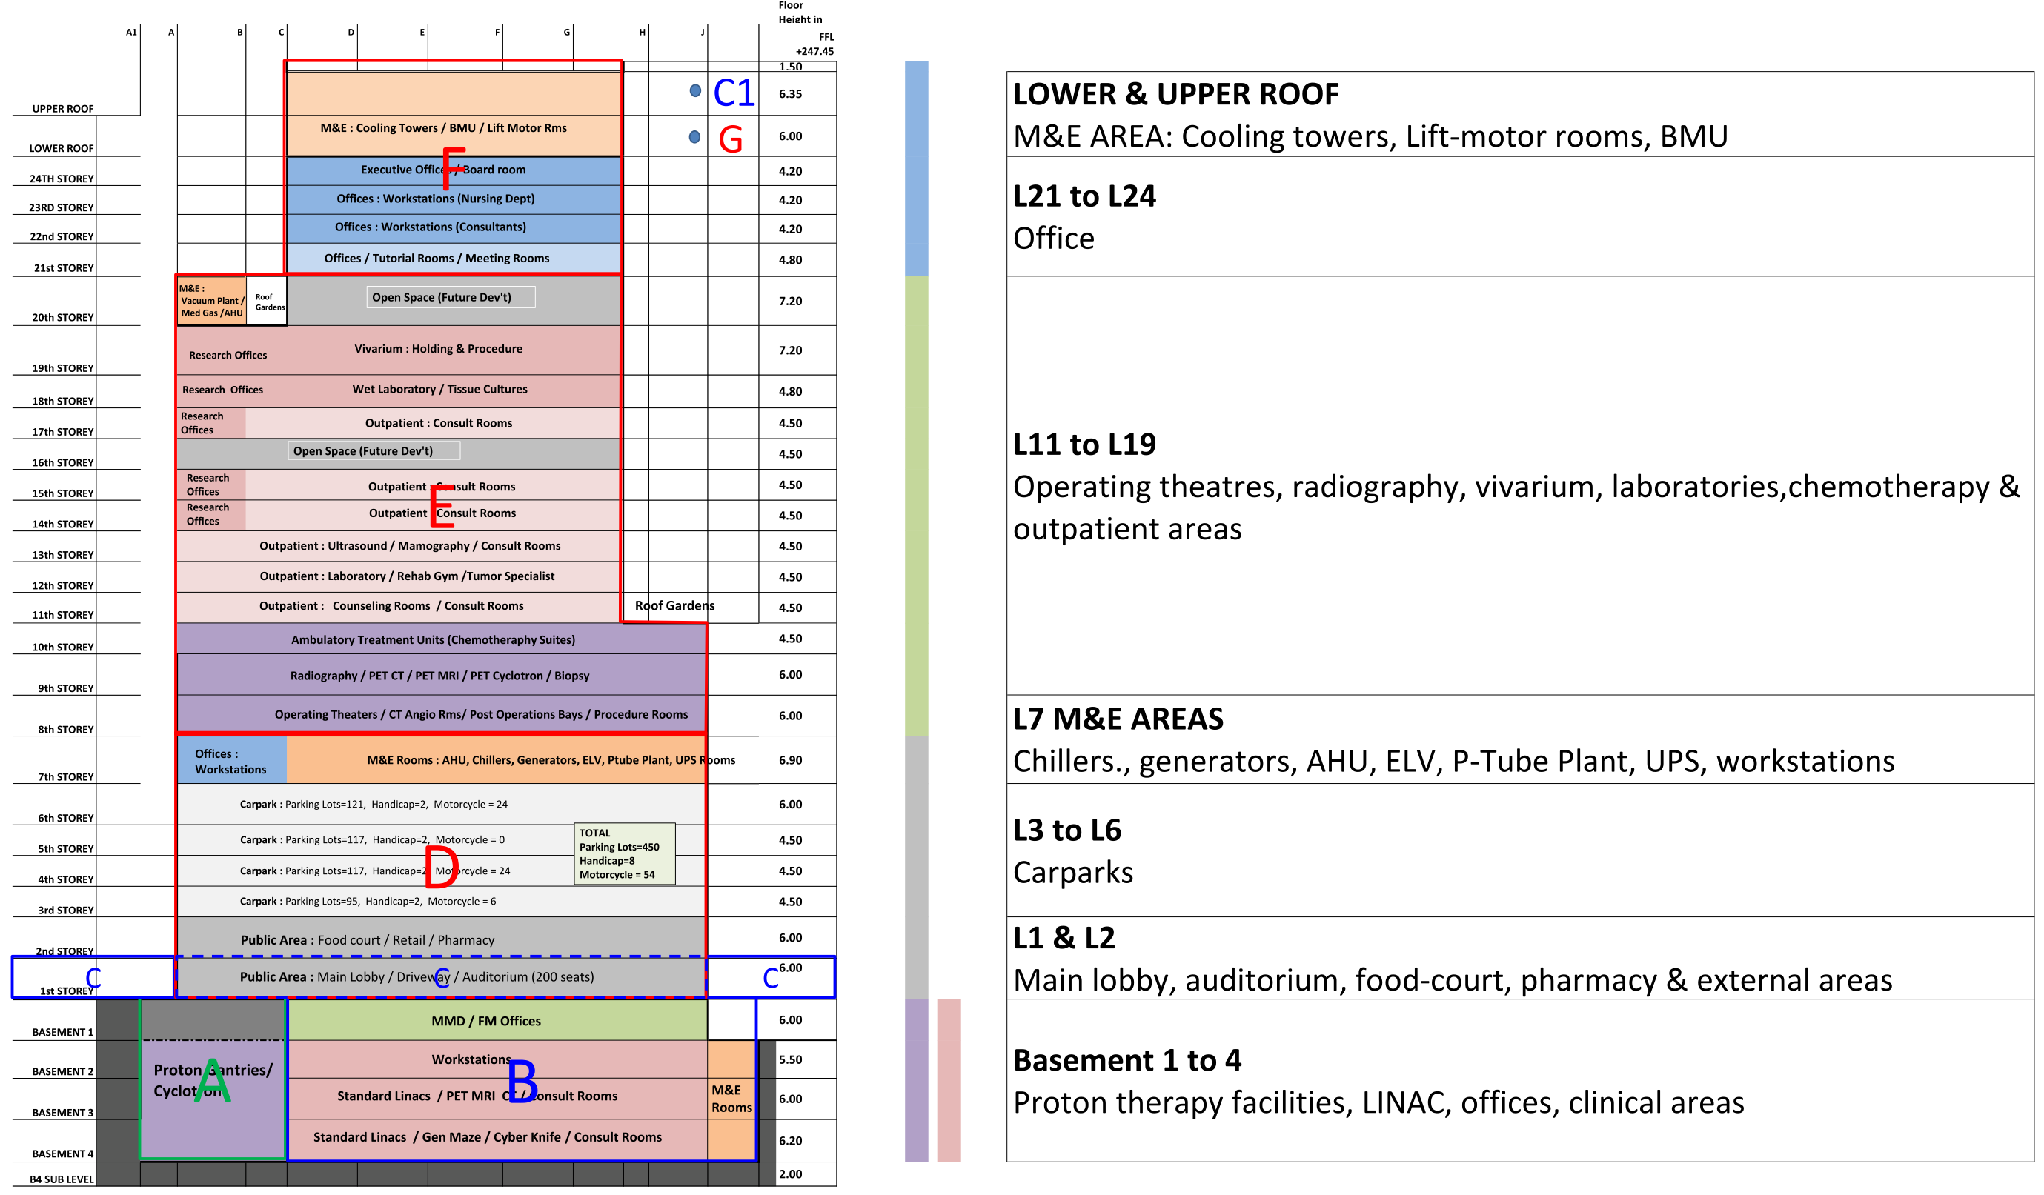
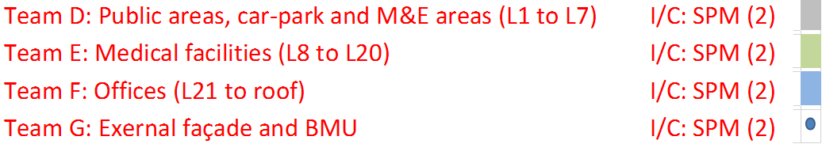
WORKS DEMARCATION
L8 to L19

Slide 4
Overall Construction sequence

Slide 5
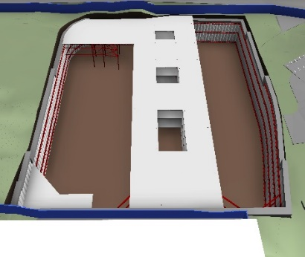
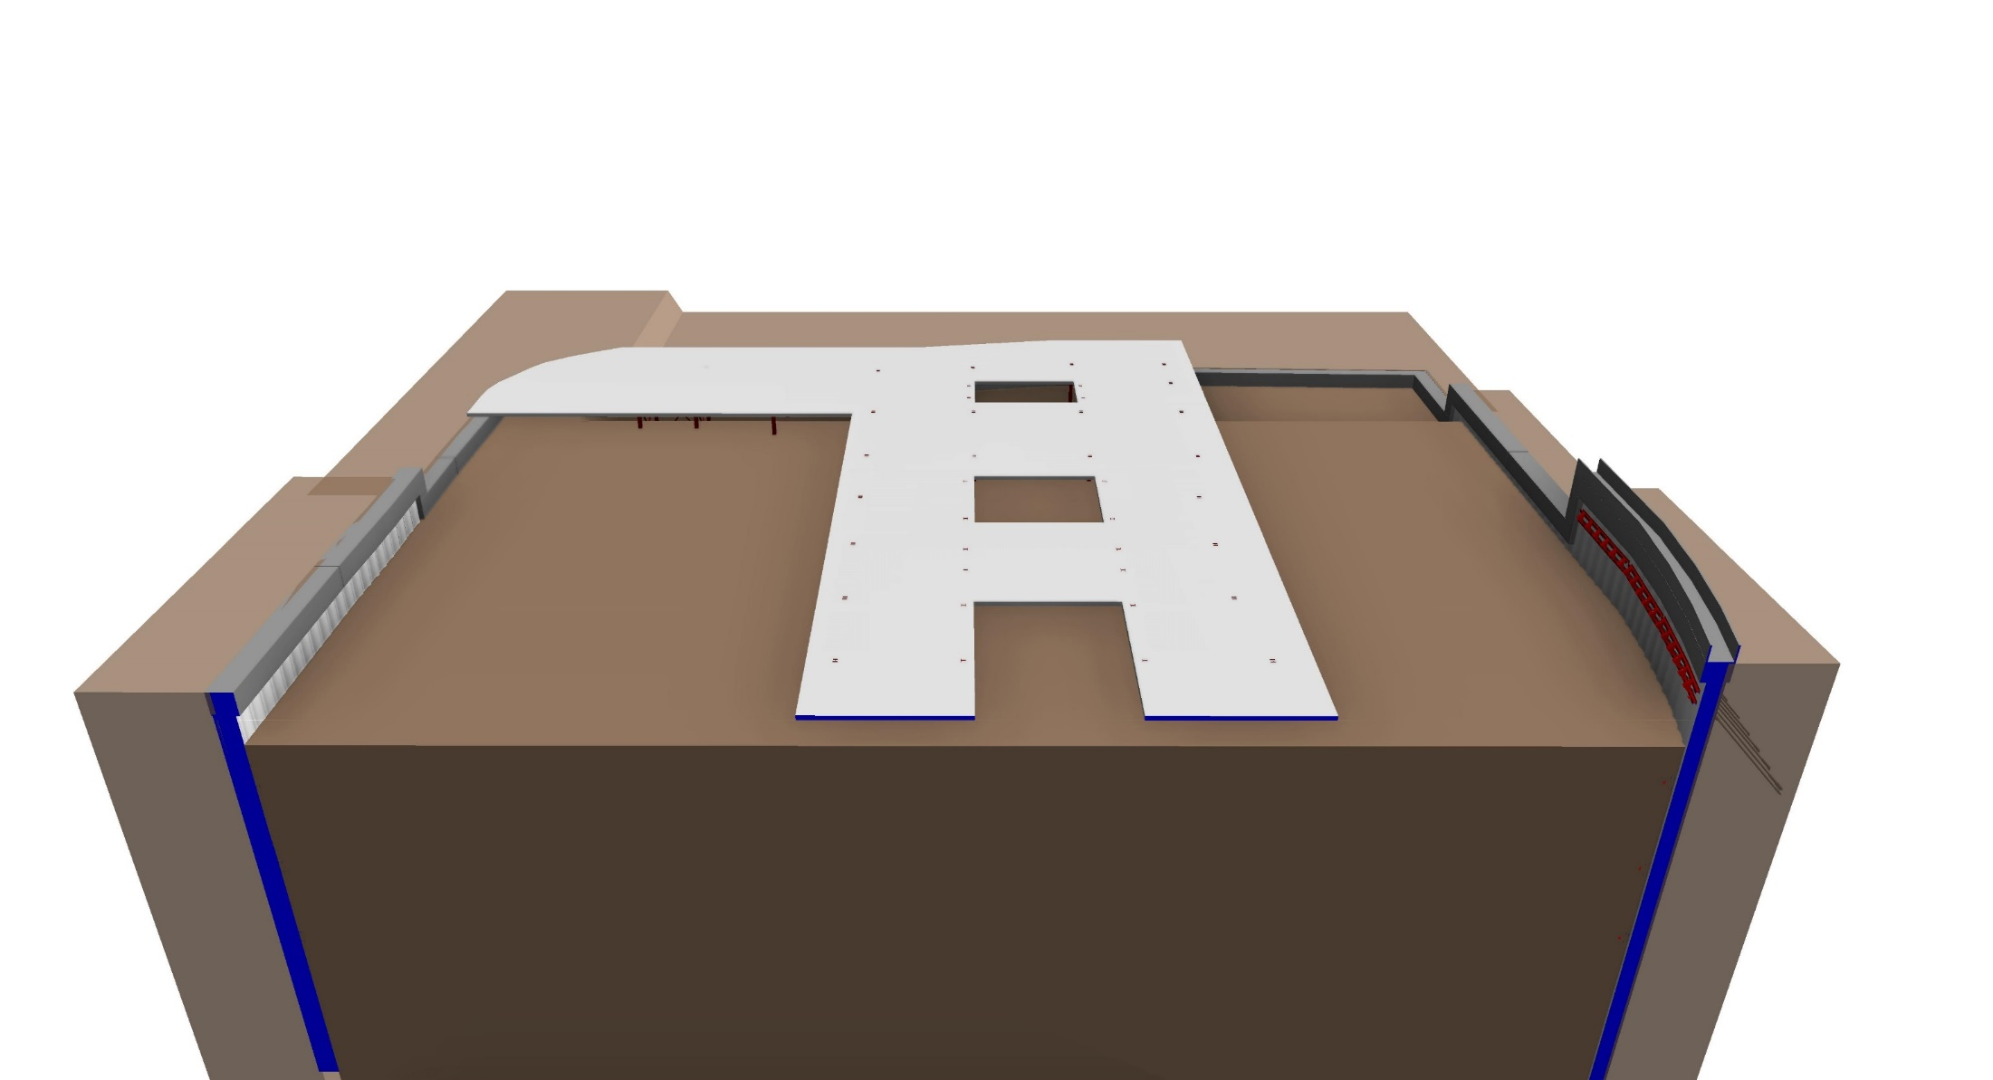
CONSTRUCTION SEQUENCE (OVERVIEW)
STAGE-1
KEYPLAN
B1 +104.60
STAGE CONSTRUCTION OF THE PROPOSED TOP-TOP CONSTRUCTION

Slide 6
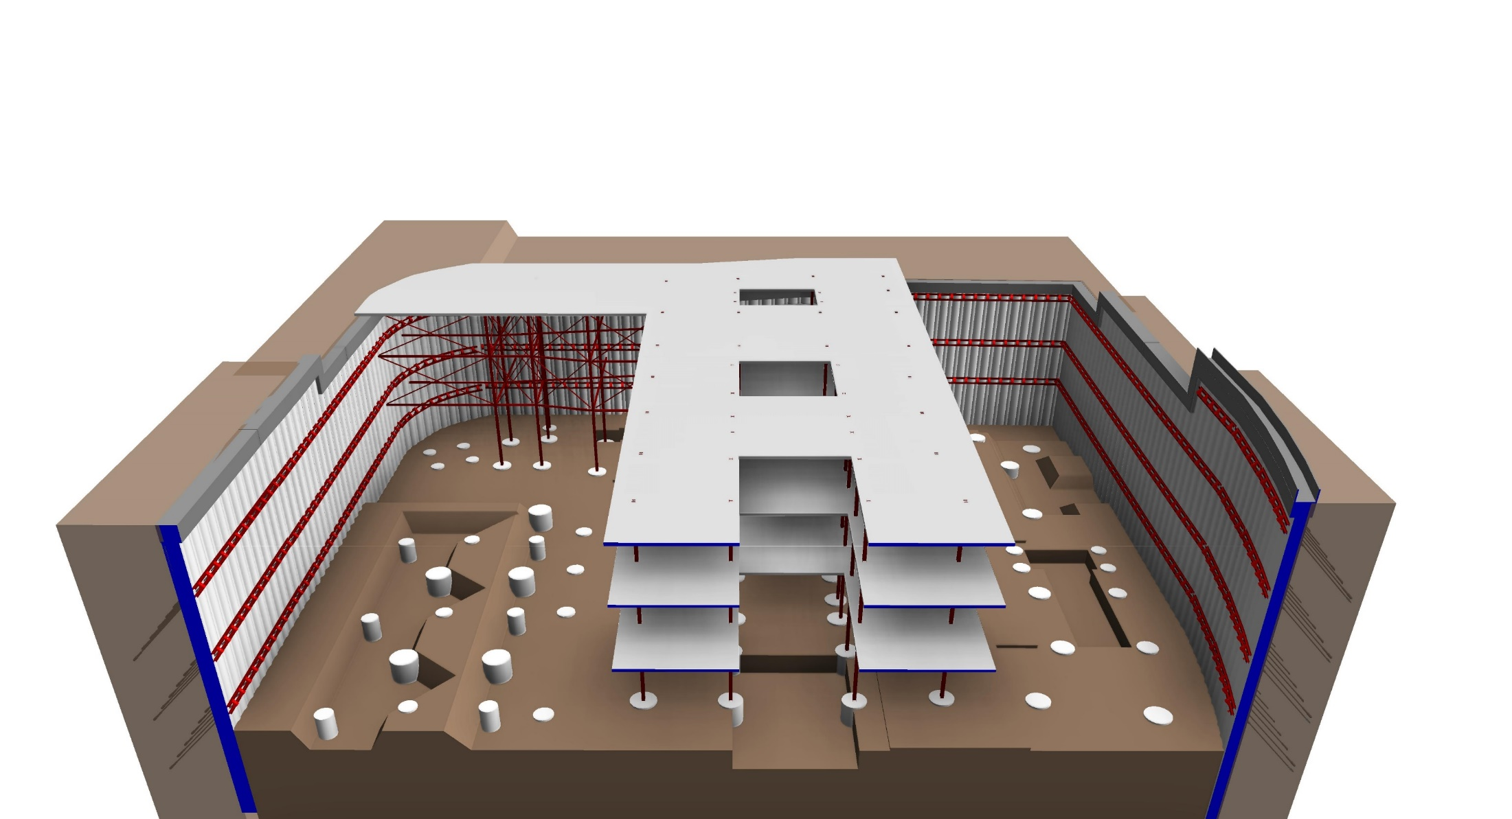
CONSTRUCTION SEQUENCE (OVERVIEW)
A
CIVIL & STRUCTURAL:
ALTERNATIVE APPROACH – TOP-TOP CONSTRUCTION
STAGE-2
KEYPLAN
B1 +104.60
B2 +99.10
B3 +93.10
STAGE CONSTRUCTION OF THE PROPOSED TOP-TOP CONSTRUCTION

Slide 7
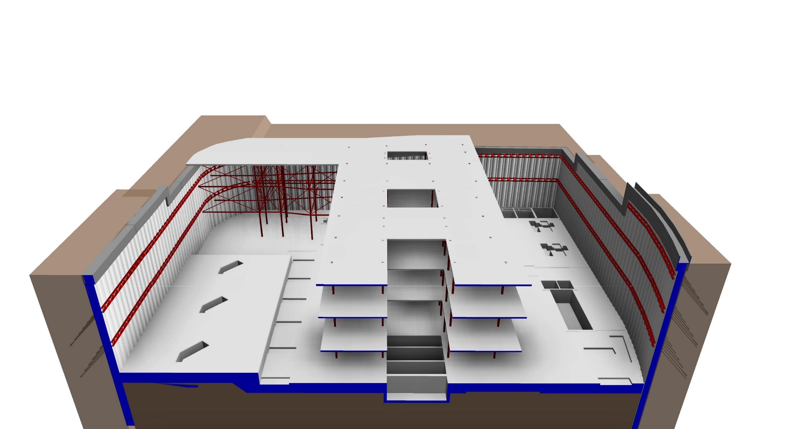
CONSTRUCTION SEQUENCE (OVERVIEW)
A
CIVIL & STRUCTURAL:
ALTERNATIVE APPROACH – TOP-TOP CONSTRUCTION
STAGE-3
KEYPLAN
B1 +104.60
B2 +99.10
B3 +93.10
B4 +86.90
STAGE CONSTRUCTION OF THE PROPOSED TOP-TOP CONSTRUCTION

Slide 8
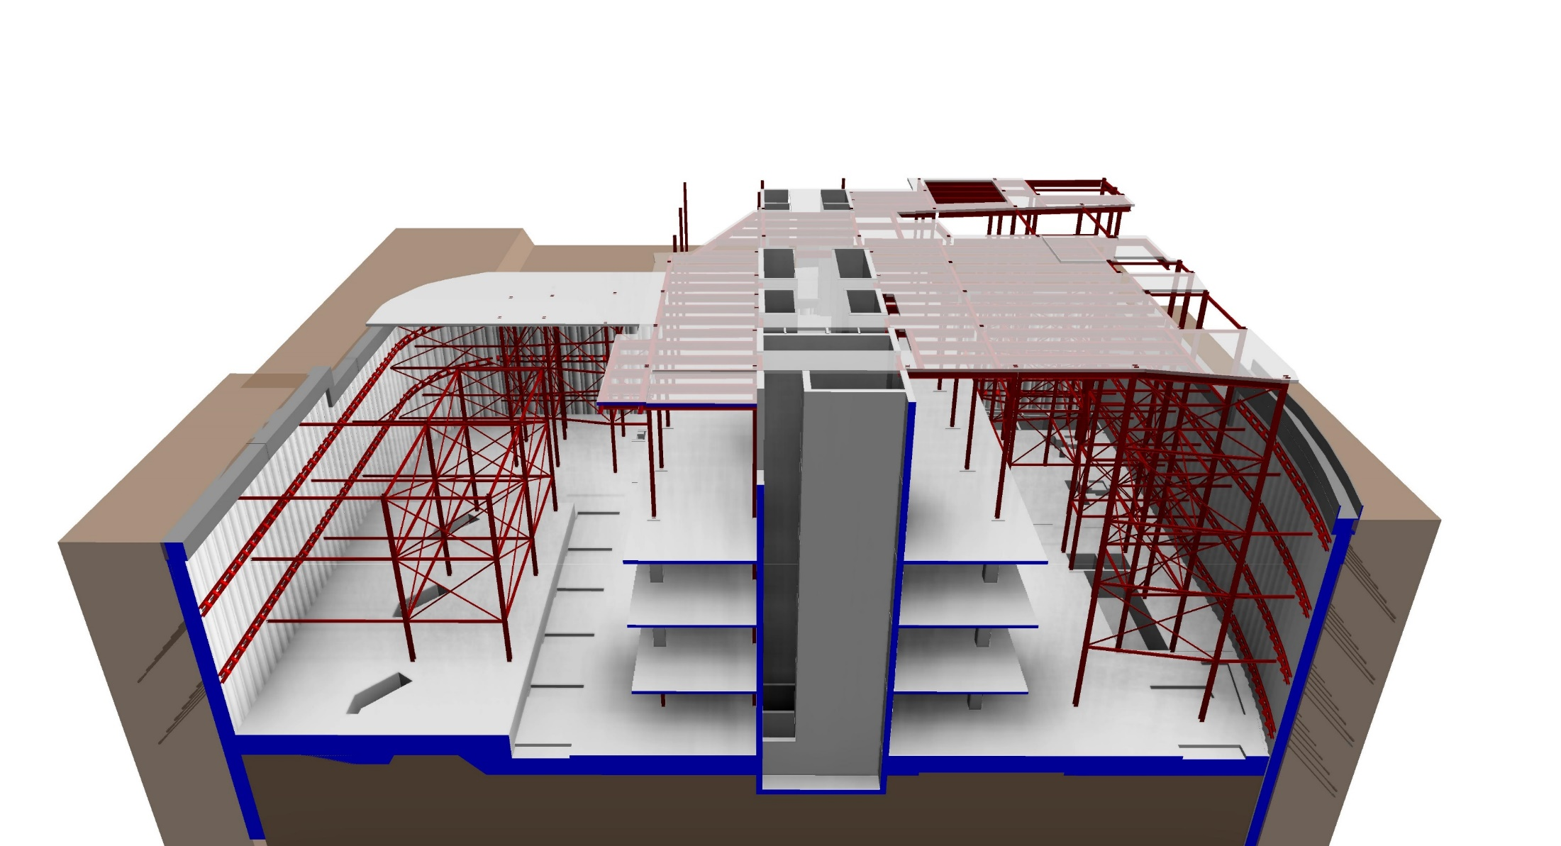
CONSTRUCTION SEQUENCE (OVERVIEW)
A
CIVIL & STRUCTURAL:
ALTERNATIVE APPROACH – TOP-TOP CONSTRUCTION
STAGE-4
KEYPLAN
2F +116.60
B1 +104.60
B2 +99.10
B3 +93.10
B4 +86.90
STAGE CONSTRUCTION OF THE PROPOSED TOP-TOP CONSTRUCTION

Slide 9
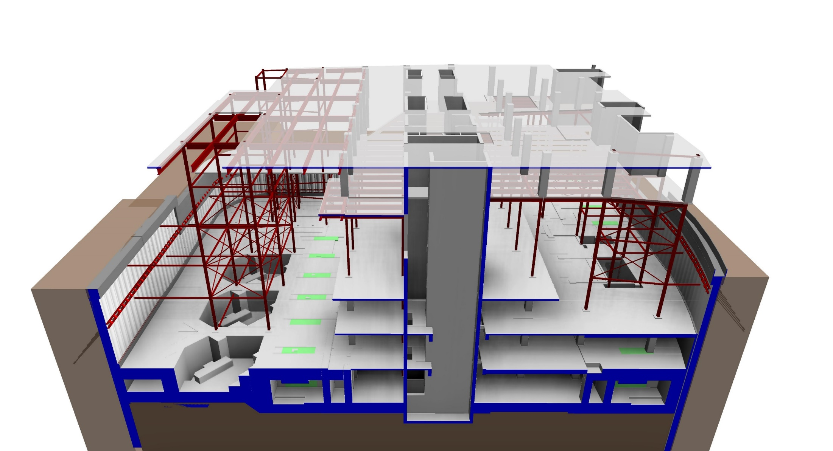
CONSTRUCTION SEQUENCE (OVERVIEW)
A
CIVIL & STRUCTURAL:
ALTERNATIVE APPROACH – TOP-TOP CONSTRUCTION
STAGE-5
KEYPLAN
3F +122.60
2F +116.60
B1 +104.60
B2 +99.10
B3 +93.10
B4 +86.90
STAGE CONSTRUCTION OF THE PROPOSED TOP-TOP CONSTRUCTION

Slide 10
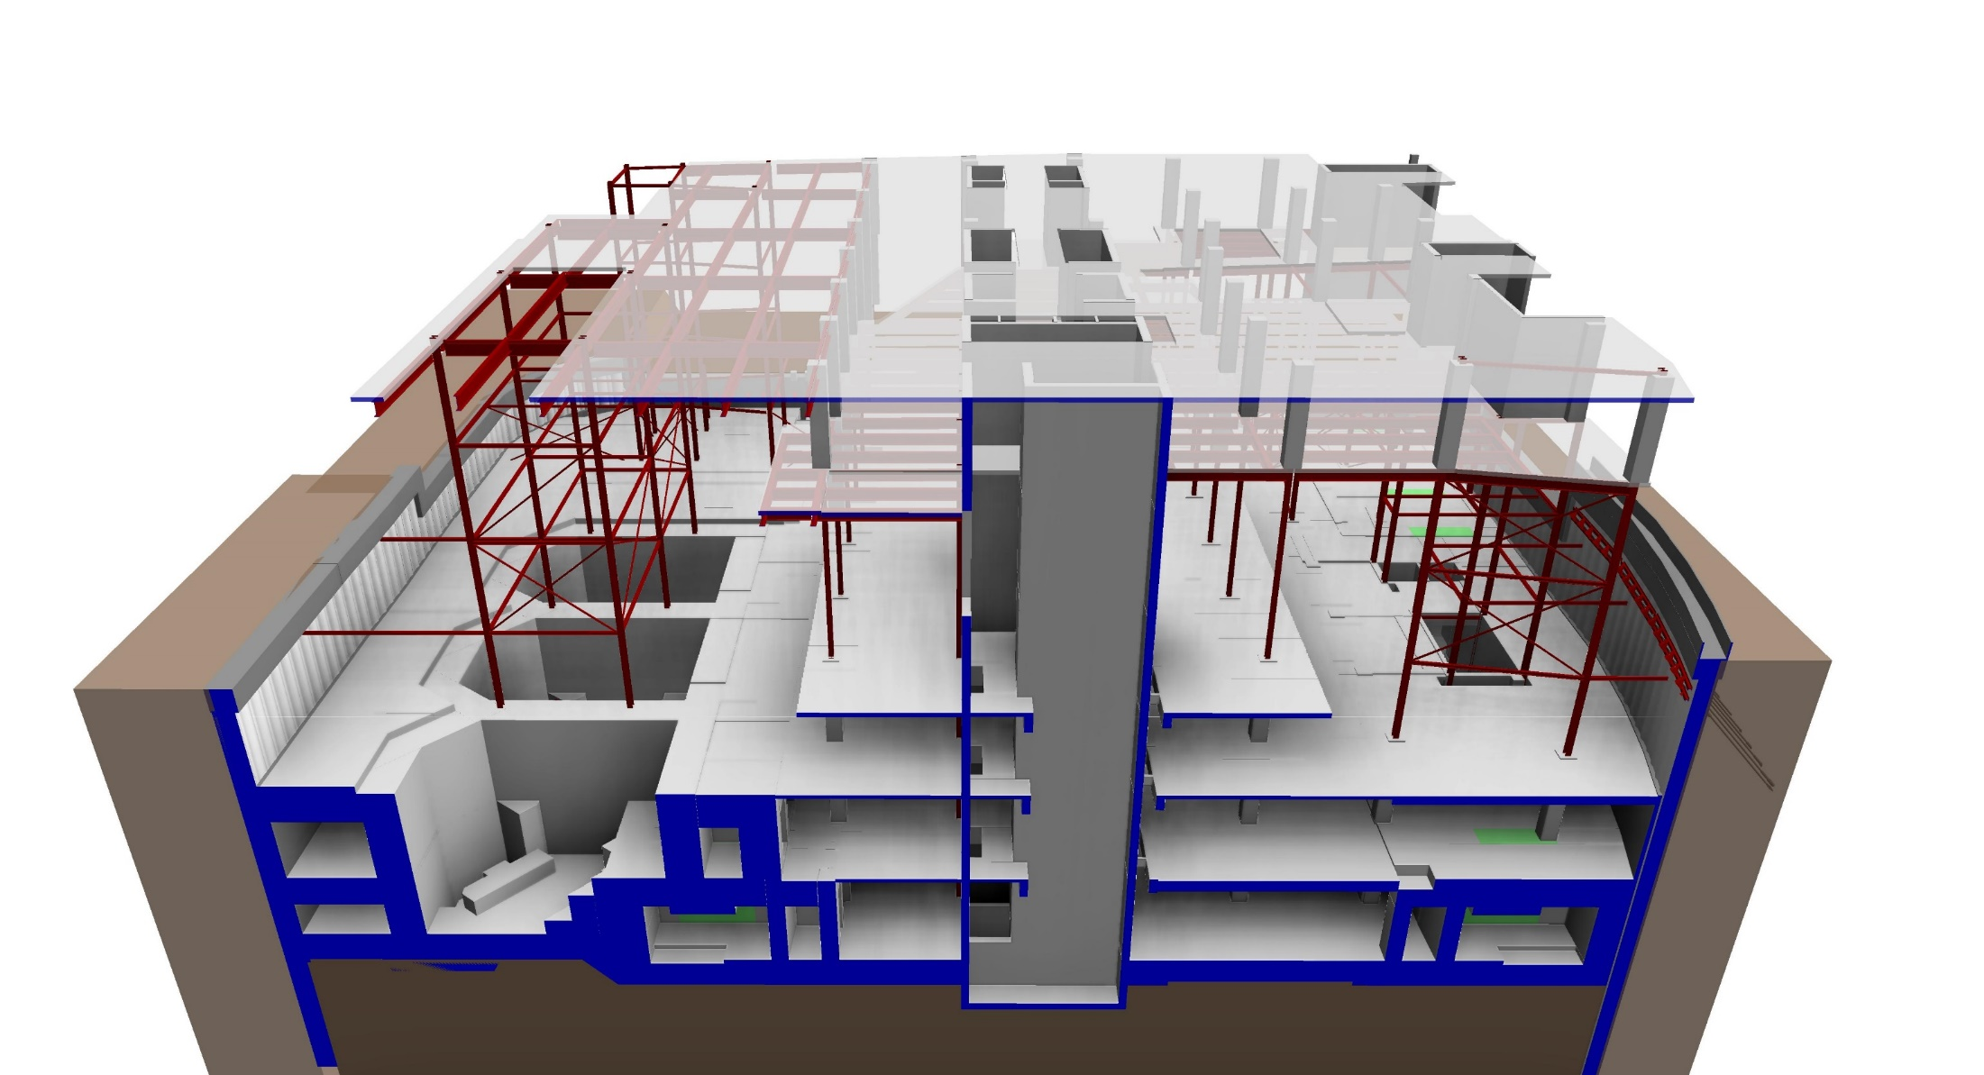
CONSTRUCTION SEQUENCE (OVERVIEW)
A
CIVIL & STRUCTURAL:
ALTERNATIVE APPROACH – TOP-TOP CONSTRUCTION
STAGE-6
5F ~ 6F
KEYPLAN
3F +122.60
2F +116.60
B1 +104.60
B2 +99.10
B3 +93.10
B4 +86.90
STAGE CONSTRUCTION OF THE PROPOSED TOP-TOP CONSTRUCTION

Slide 11
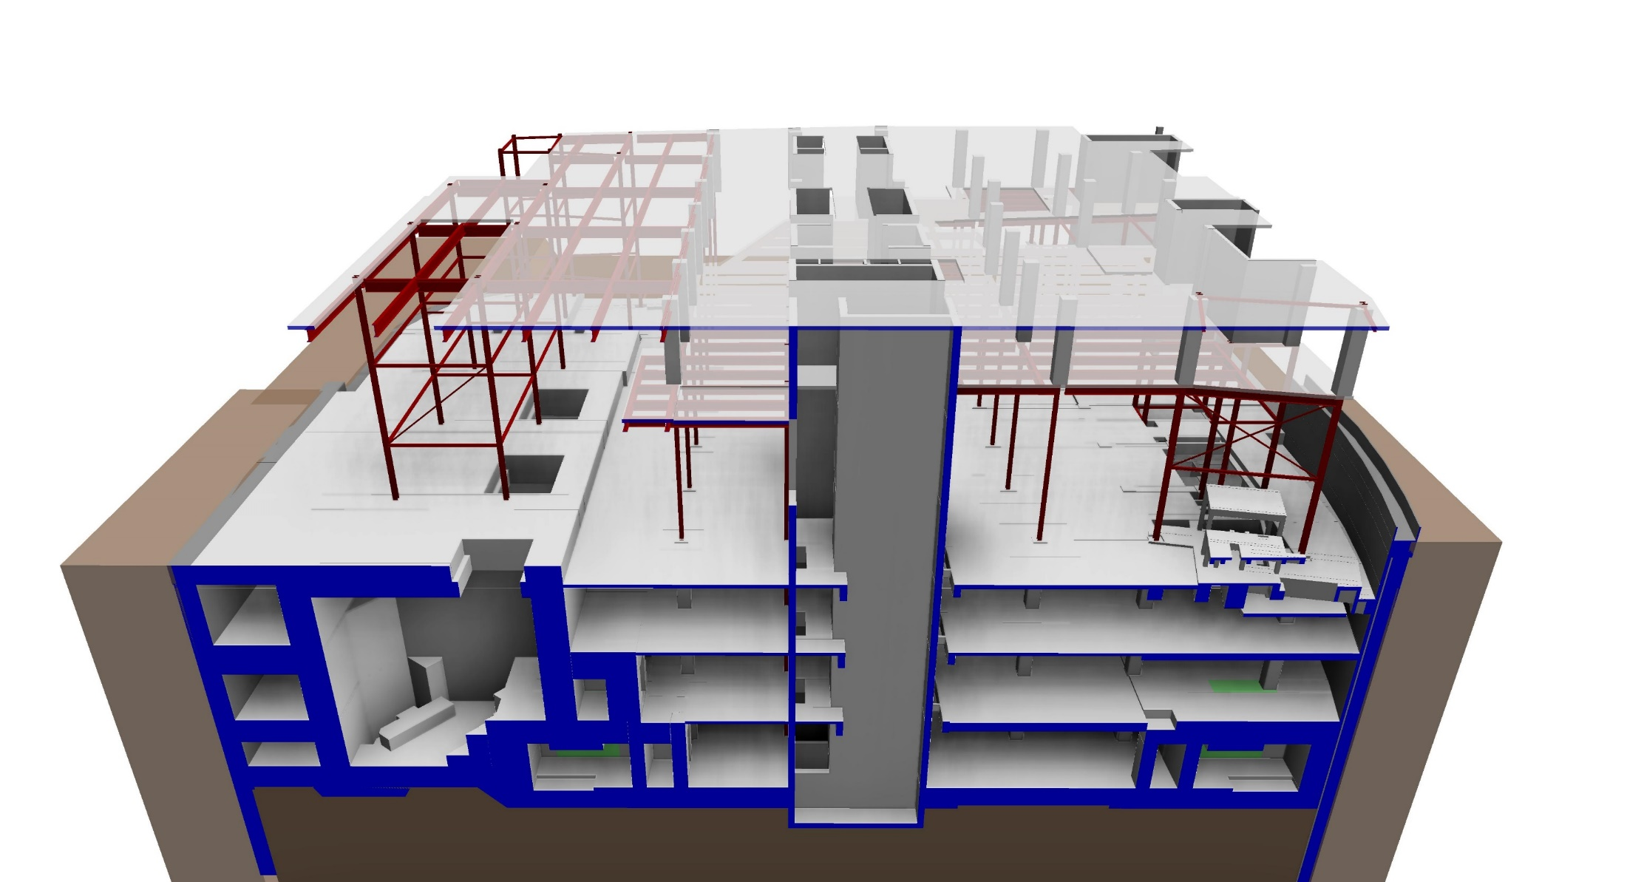
CONSTRUCTION SEQUENCE (OVERVIEW)
A
CIVIL & STRUCTURAL:
ALTERNATIVE APPROACH – TOP-TOP CONSTRUCTION
STAGE-7
8F ~ 9F
KEYPLAN
3F +122.60
2F +116.60
B1 +104.60
B2 +99.10
B3 +93.10
B4 +86.90
STAGE CONSTRUCTION OF THE PROPOSED TOP-TOP CONSTRUCTION

Slide 12
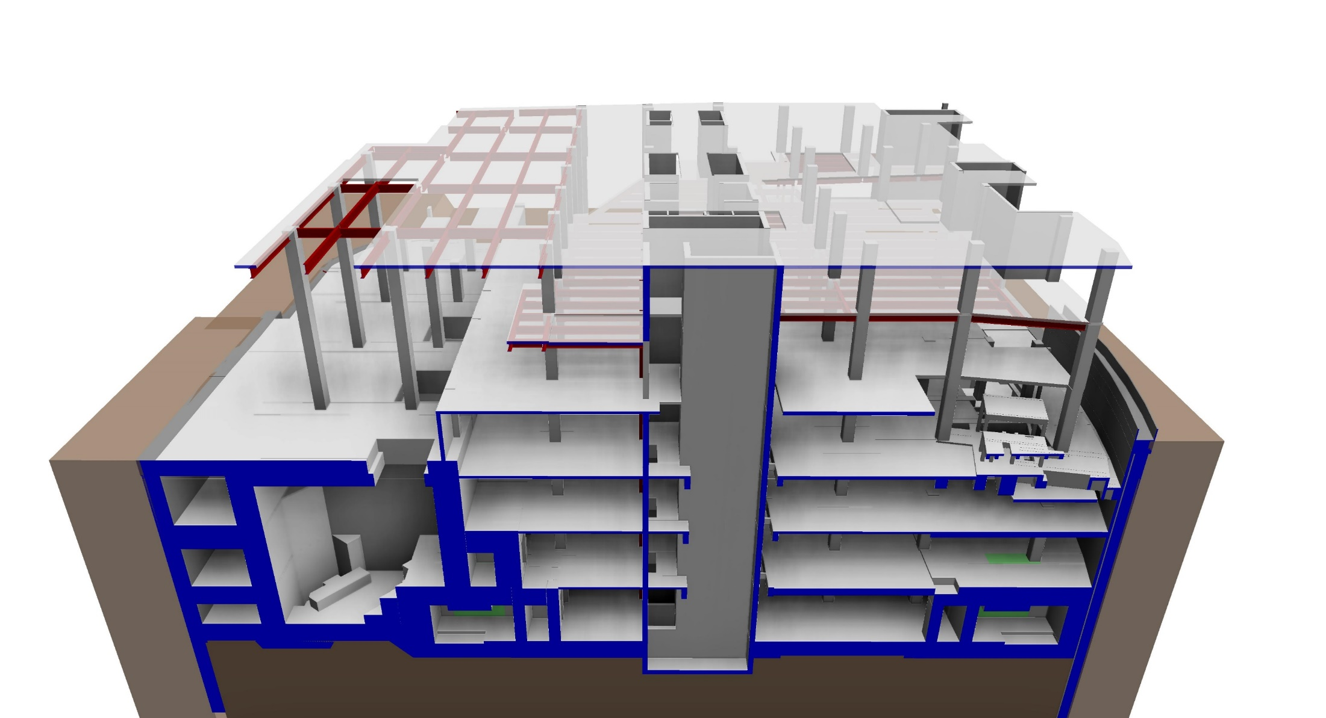
CONSTRUCTION SEQUENCE (OVERVIEW)
A
CIVIL & STRUCTURAL:
ALTERNATIVE APPROACH – TOP-TOP CONSTRUCTION
STAGE-8
12F ~ 13F
KEYPLAN
3F +122.60
2F +116.60
1F +110.60
B1 +104.60
B2 +99.10
B3 +93.10
B4 +86.90
STAGE CONSTRUCTION OF THE PROPOSED TOP-TOP CONSTRUCTION

Slide 13
CONSTRUCTION SEQUENCE (OVERVIEW)
A
CIVIL & STRUCTURAL:
ALTERNATIVE APPROACH – TOP-TOP CONSTRUCTION
STAGE-9
M29
24F
KEYPLAN
3F +122.60
2F +116.60
1F +110.60
B1 +104.60
B2 +99.10
B3 +93.10
B4 +86.90
STAGE CONSTRUCTION OF THE PROPOSED TOP-TOP CONSTRUCTION

Slide 14
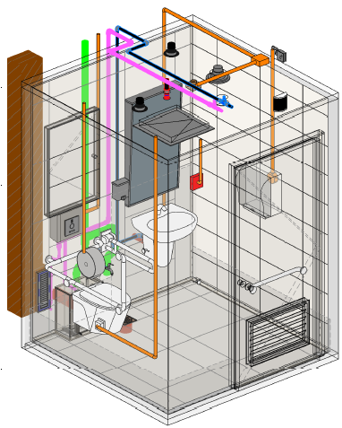
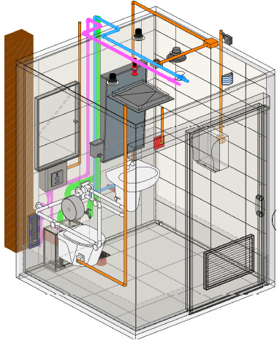
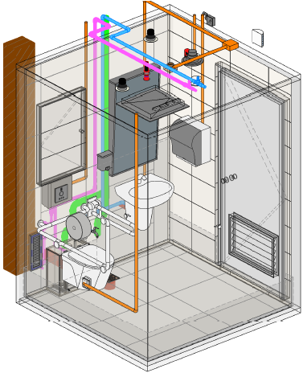
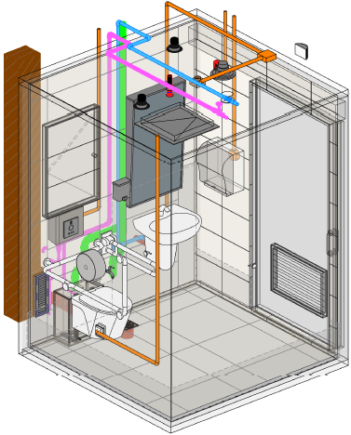
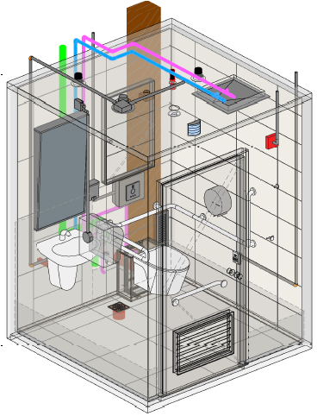
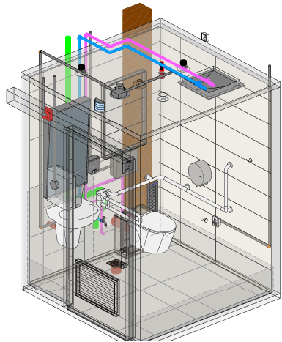
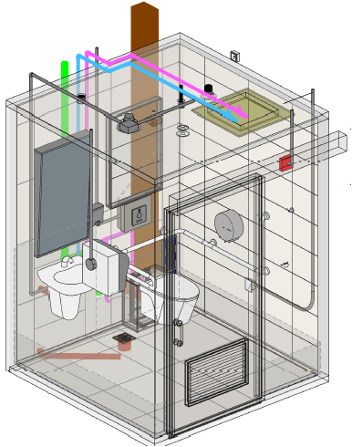
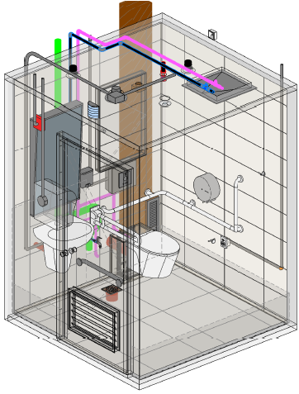
PREFABRICATED BATHROOM UNIT
Total unit = 153;
Tonnage = 3.5T
2040
mm
2040
mm
PBU Types & Detail drawings
2700
mm
Type A1
Type A2
Type A3
Type A4
Type B1
Type B2
Type B3
Type B4

Slide 15
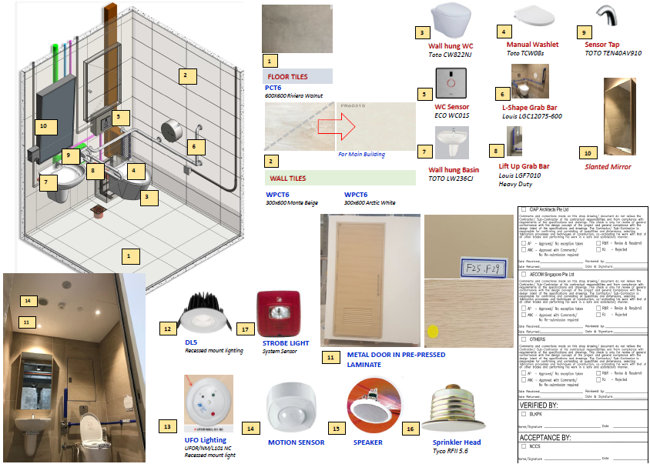
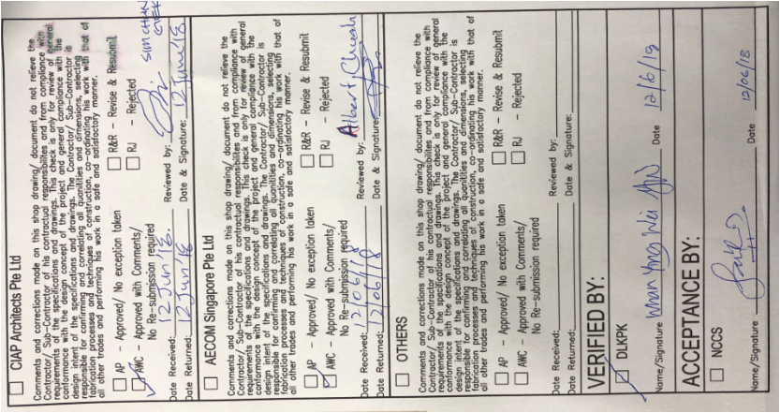
PREFABRICATED BATHROOM UNIT
PBU approved finishes for NCCS

Slide 16
BIM COORDINATION

Slide 17
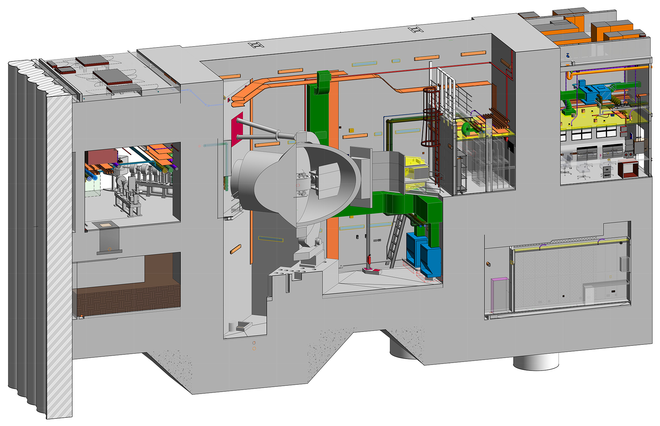
DRAWING / BIM COORDINATION

Slide 18
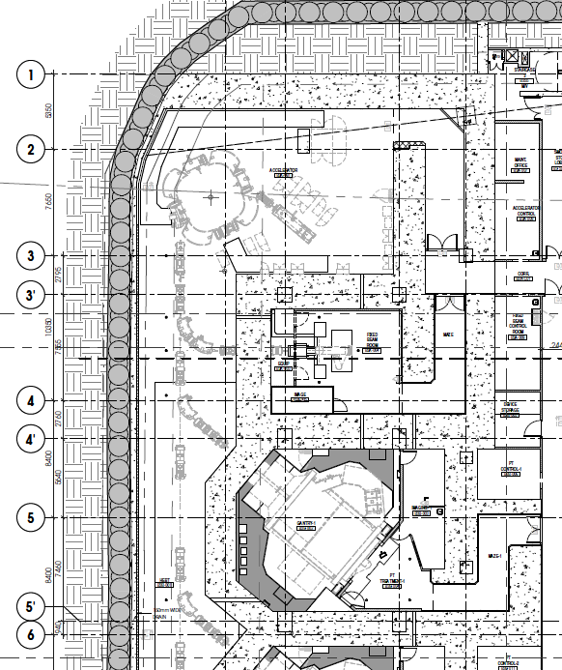
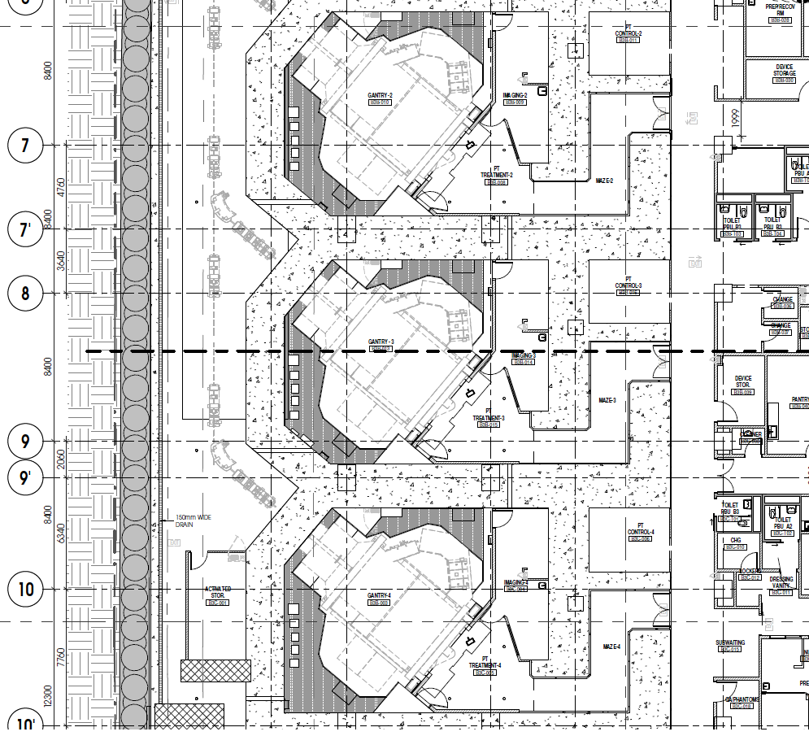
DRAWING / BIM COORDINATION
Synchrotron Area
Gantry 3
H E B T
Treatment 3

Slide 19
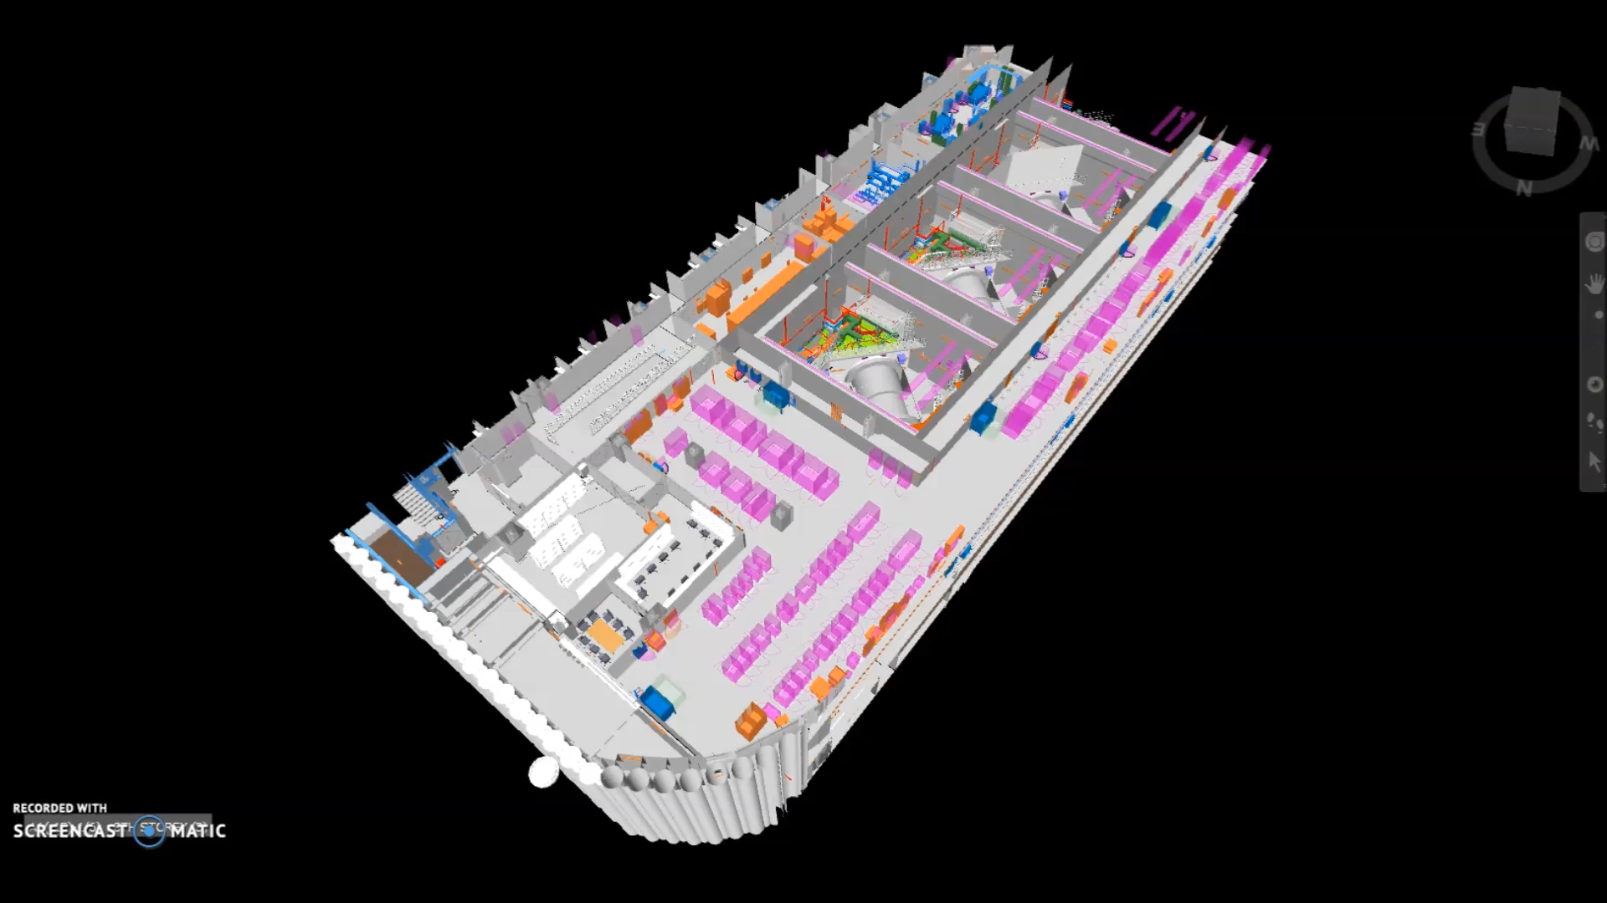
DRAWING / BIM COORDINATION

Slide 20
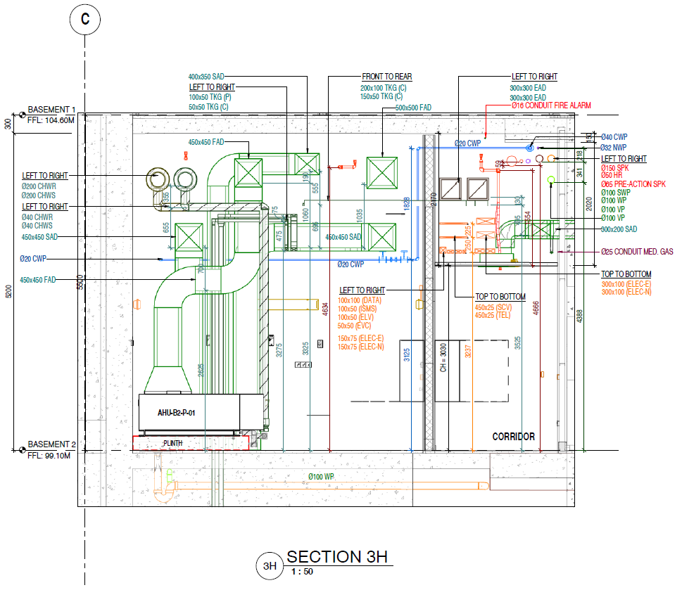
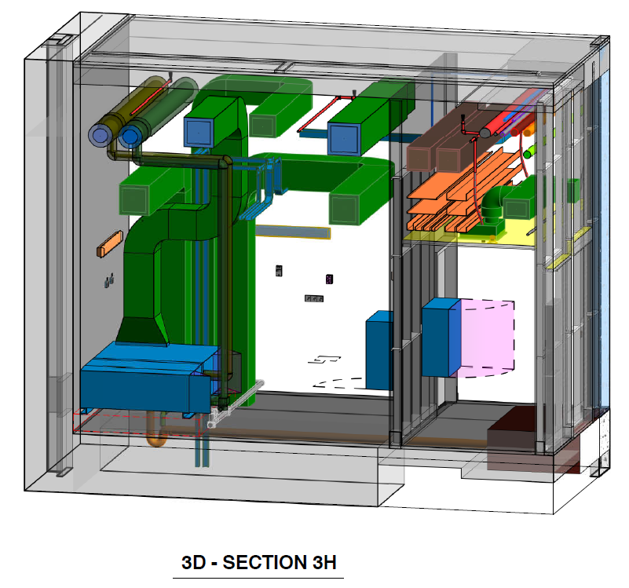
DRAWING / BIM COORDINATION

Slide 21
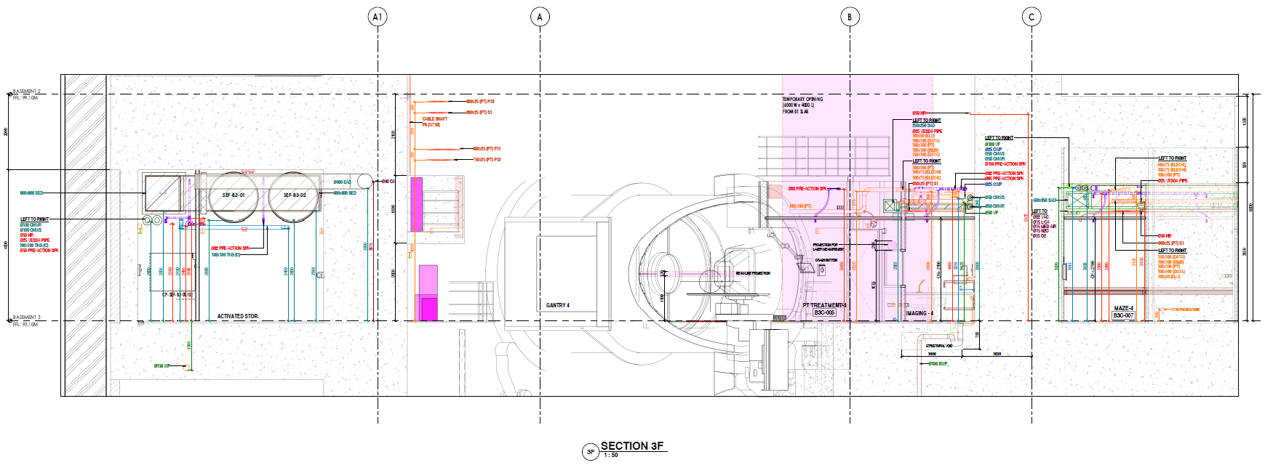
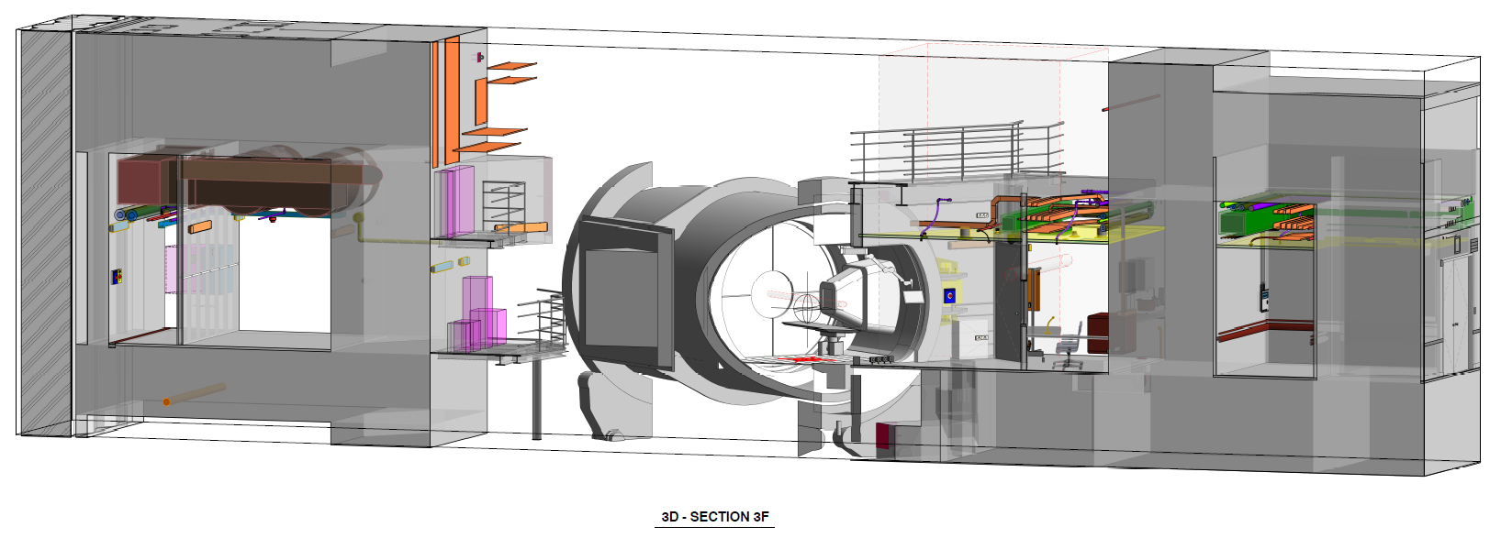
DRAWING / BIM COORDINATION

Slide 22
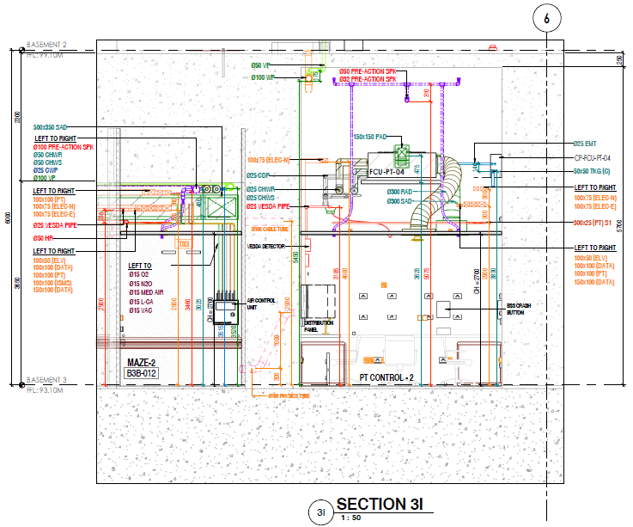
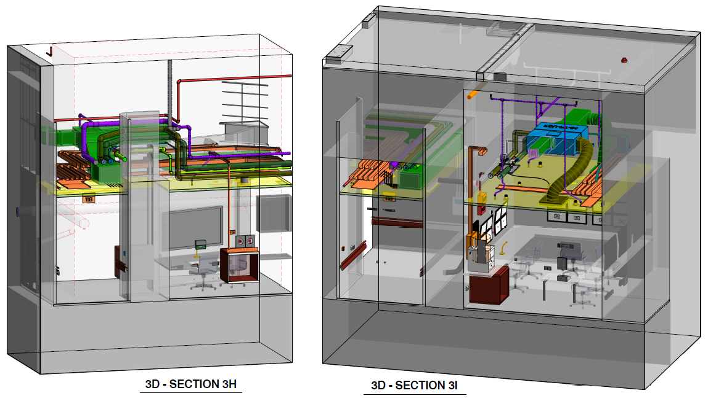
DRAWING / BIM COORDINATION
C:\Users\gan.cheemeng\Desktop\PT B2-B4 CSD\Final\SDA-625-S Basement 2 Bunker Penetration.pdf

Slide 23
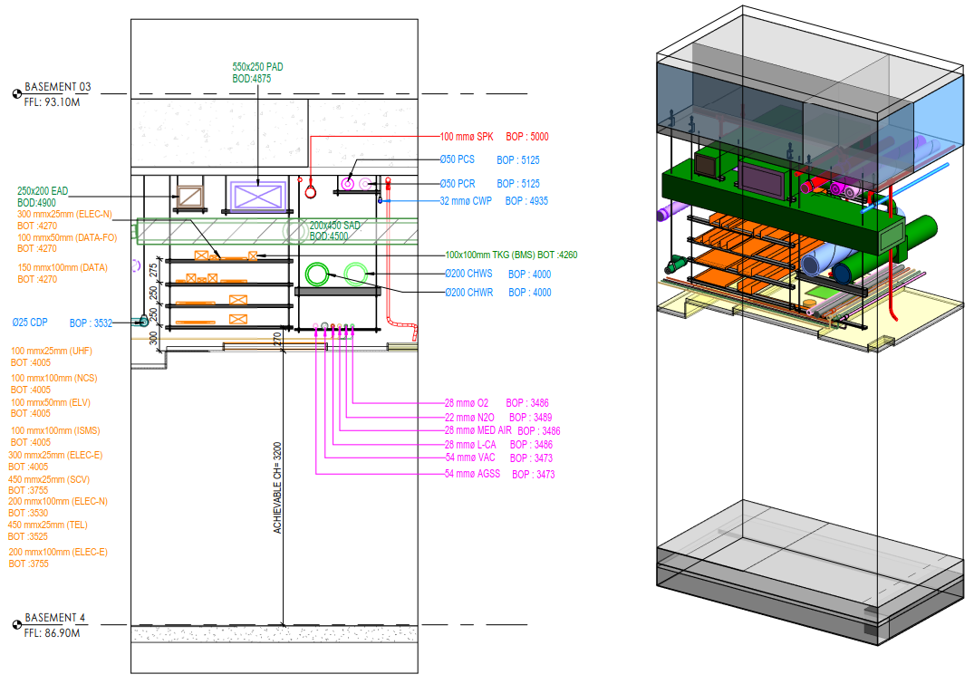
DRAWING BIM COORDINATION

Slide 24
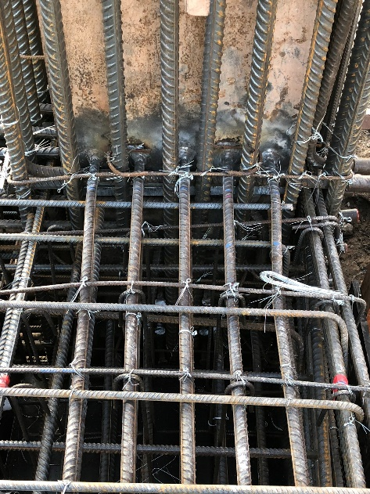
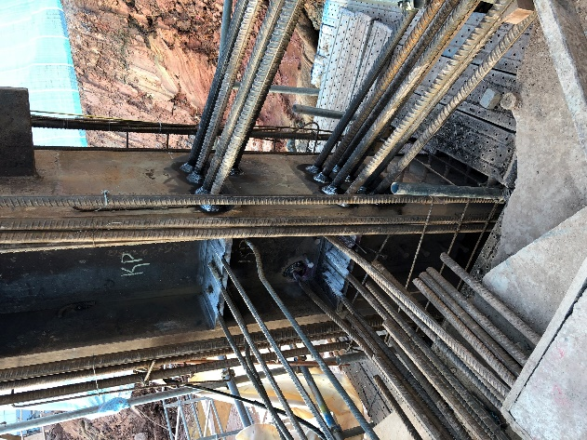
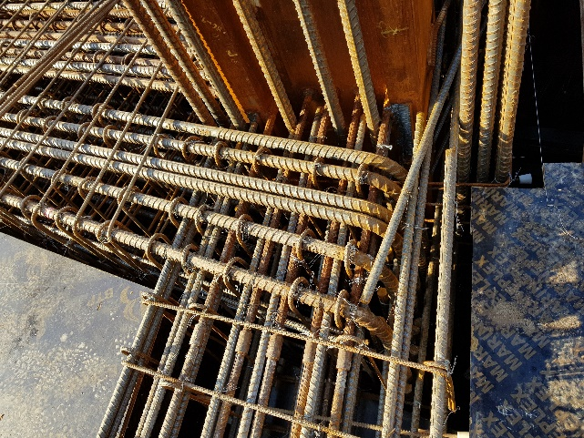

Slide 25
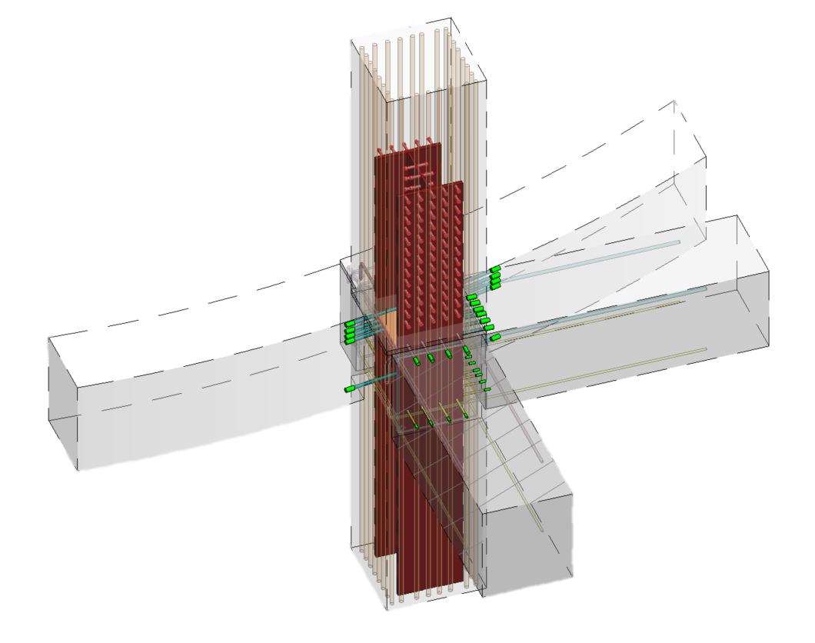
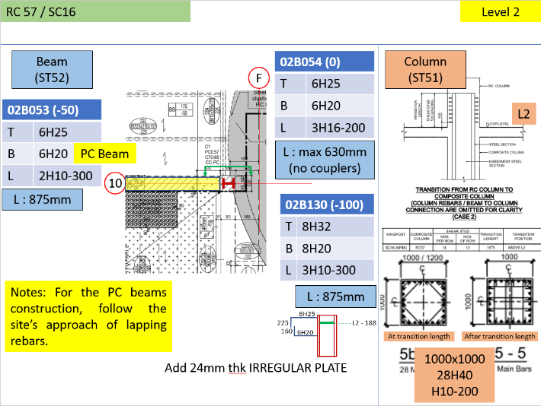
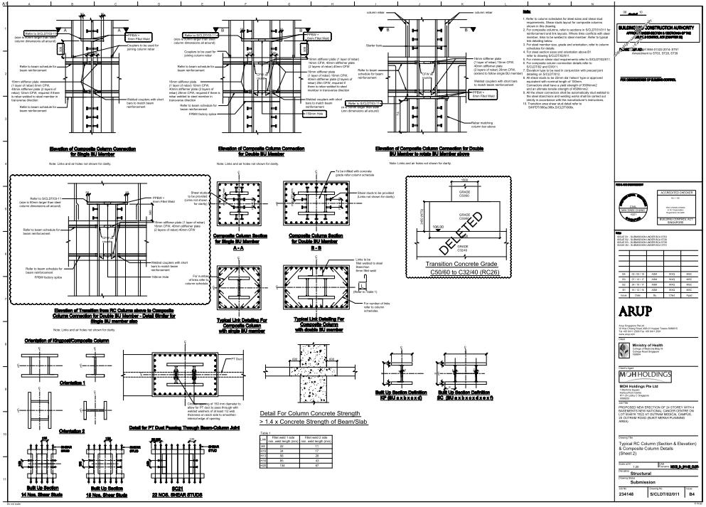
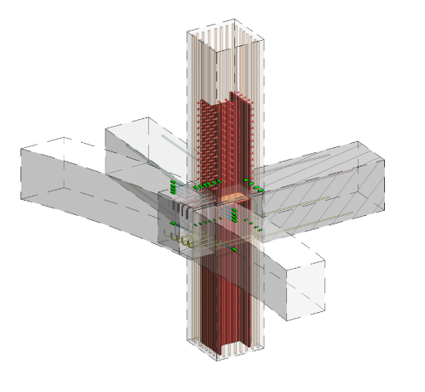
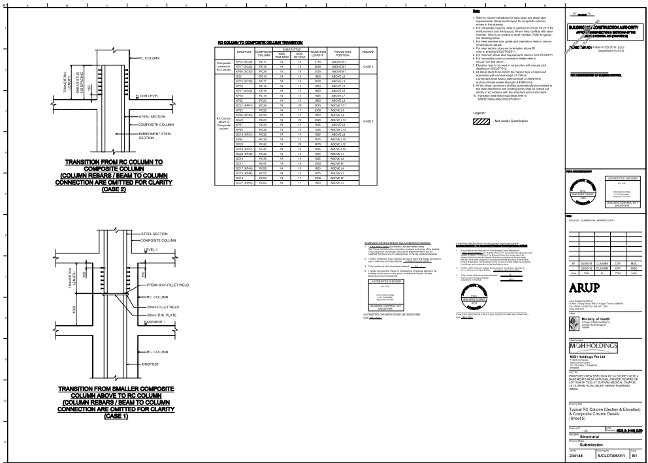
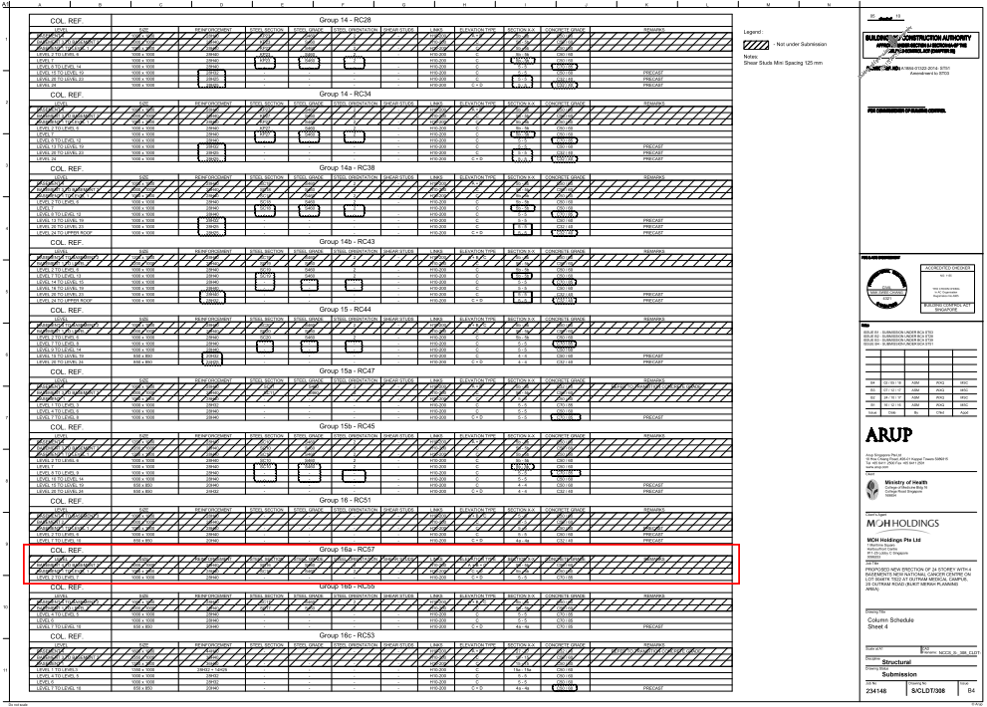
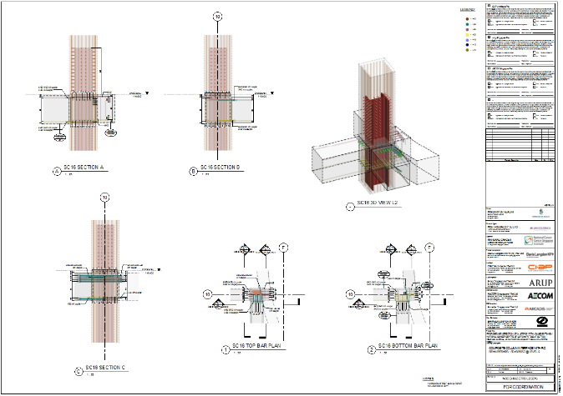
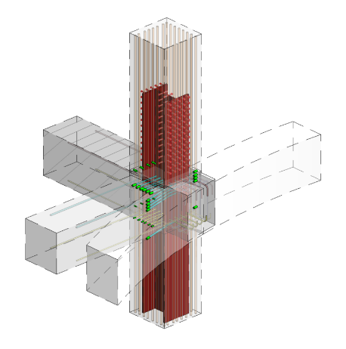
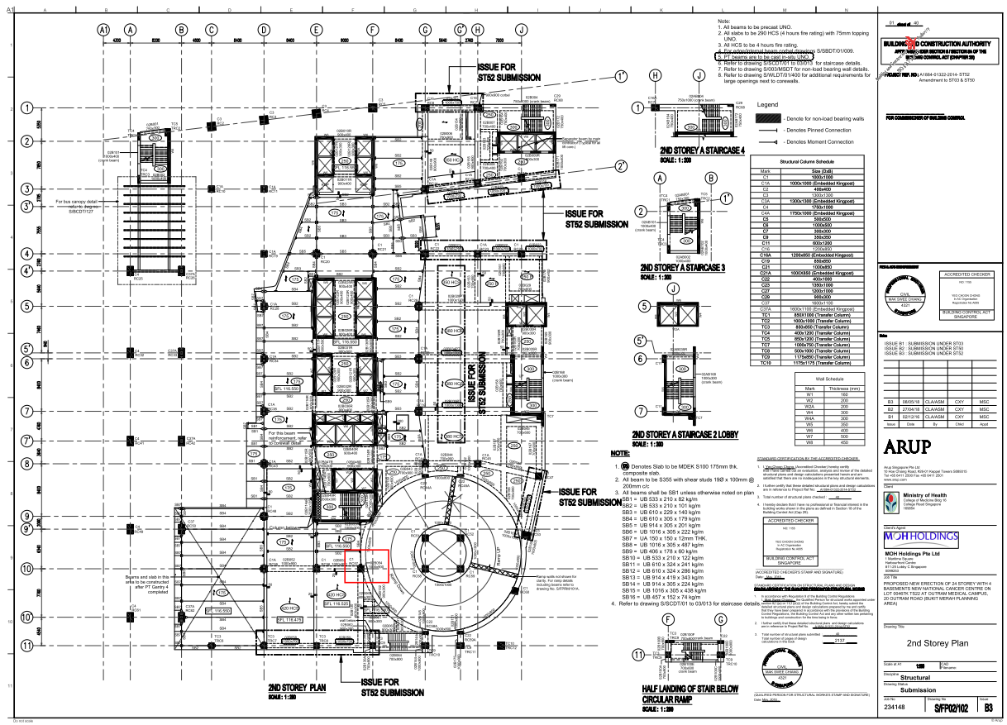
RC57 – SC16 @ L2
INTERPRETATION OF DESIGN
DESIGN DRAWINGS
3D MODELLING IN REVIT

